Slide 1
Dimension reduction and autoencoders
Hung-Hsuan Chen

Slide 2
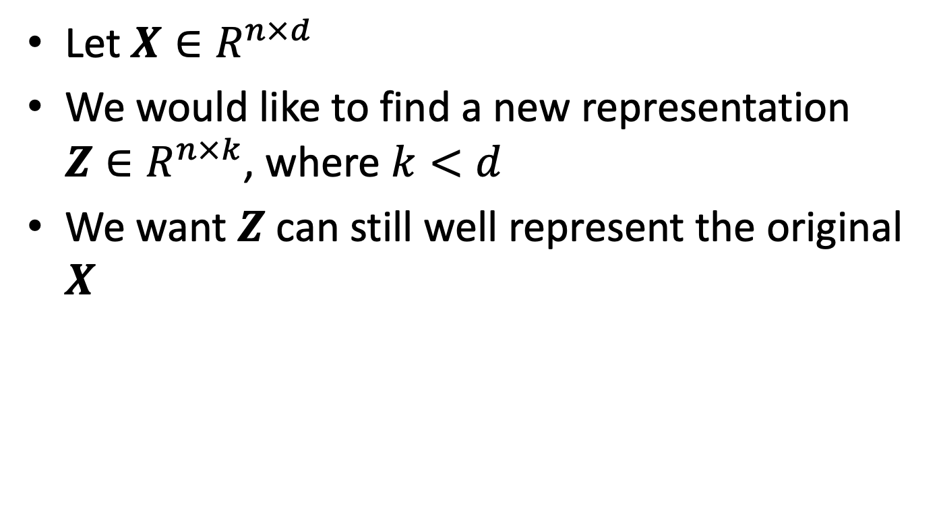
Dimension reduction
Let $X∈R^{n×d}$
We would like to find a new representation $Z∈R^{n×k}$, where $k<d$
We want $Z$ can still well represent the original $X$

Slide 3
Why dimension reduction?
Compress data and preserve useful information
Data visualization

Slide 4
Toy example 1
Consider the following 3d points
(1,2,3), (2,4,6), (3,6,9), (4,8,12), (5,10,15), (6,12,18)
If each integer requires 1 byte, we need 1*3*6=18 bytes
However, we may also store the first point (1,2,3) as the base, and store the multiplier of each point
One point (3 bytes) + multipliers (6 bytes)
Reduced 50% of the storage

Slide 5
Toy example (con’t)
Consider the following 3d points
(1,2,3), (2,4,6), (3,6,8), (4,8,12), (5,10,15), (6,12,19)
If each integer requires 1 byte, we need 1*3*6=18 bytes
If we store the first point (1,2,3) as the base, and store the multiplier of each point
One point (3 bytes) + multipliers (6 bytes)
Reduced 50% of the storage
However, we have some small loss

Slide 6
Principal component analysis (PCA)

Slide 7
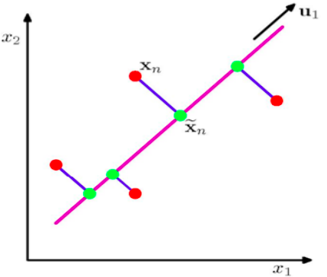
PCA
PC2
Goal: find base direction(s) that preserves “important” aspects of data
PCA
Allow only linear transforms from the original data point to the new data point
Define the goodness by
Maximizing the variance of projected data (purple line)
Minimize mean squared distance between data points and projections (blue lines)
PC1

Slide 9
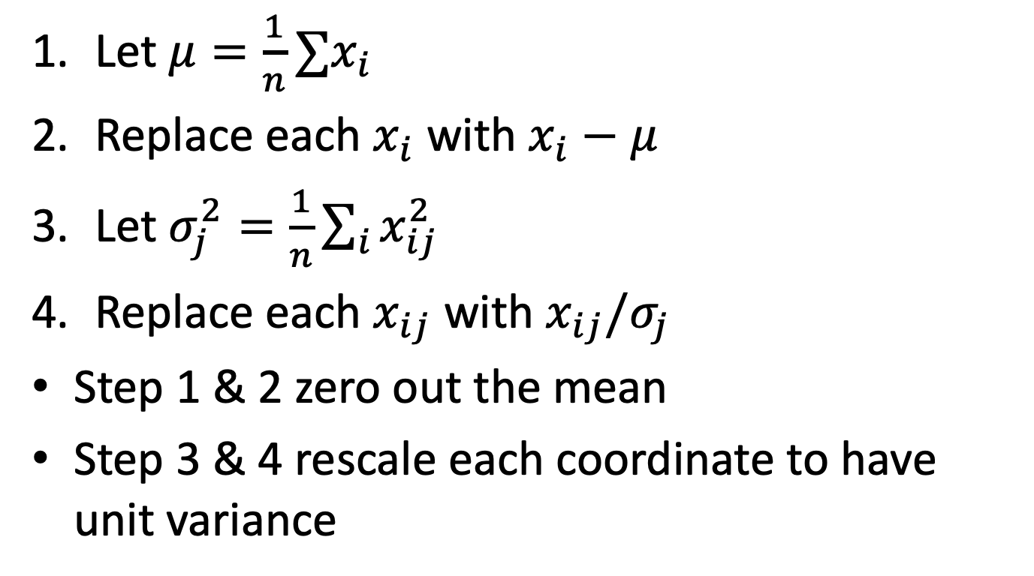
Preprocessing steps
Let $μ=\frac{1}{n}∑x_{i}$
Replace each $x_{i}$ with $x_{i}−μ$
Let $σ_{j}^{2}=\frac{1}{n}\sum_{i}{x_{ij}^{2}}$
Replace each $x_{ij}$ with $x_{ij}/σ_{j}$
Step 1 & 2 zero out the mean
Step 3 & 4 rescale each coordinate to have unit variance

Slide 10
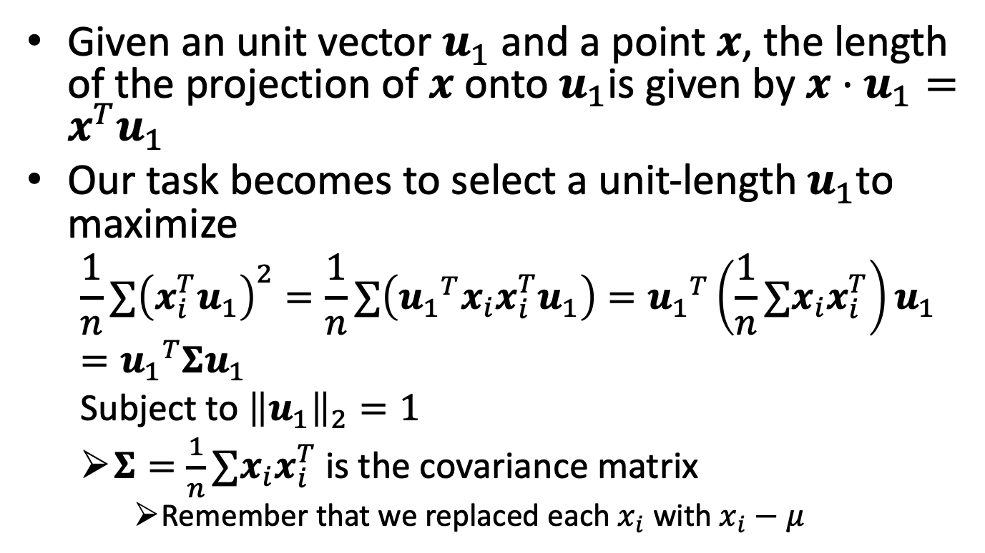

Finding $u_{1}$
Given an unit vector $u_{1}$ and a point $x$, the length of the projection of $x$ onto $u_{1}$is given by $x⋅u_{1}=x^{T}u_{1}$
Our task becomes to select a unit-length $u_{1}$to maximize
$$\frac{1}{n}∑{\left(x_{i}^{T}u_{1}\right)}^{2}=\frac{1}{n}∑\left({u_{1}}^{T}x_{i}x_{i}^{T}u_{1}\right)={u_{1}}^{T}\left(\frac{1}{n}∑x_{i}x_{i}^{T}\right)u_{1}={u_{1}}^{T}Σu_{1}$$
Subject to ${\left\|u_{1}\right\|}_{2}=1$
$Σ=\frac{1}{n}∑x_{i}x_{i}^{T}$ is the covariance matrix
Remember that we replaced each $x_{i}$ with $x_{i}−μ$

Slide 11
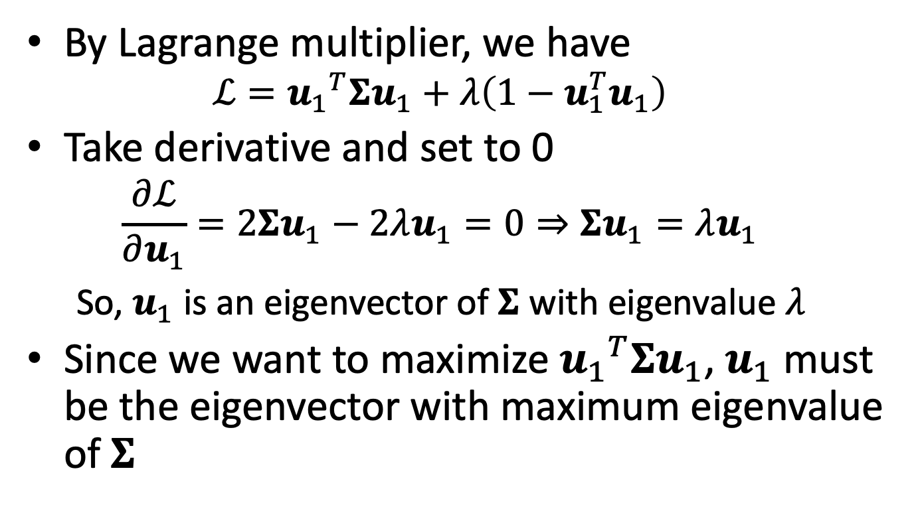

Finding $u_{1}$ (cont’)
By Lagrange multiplier, we have
$$ℒ={u_{1}}^{T}Σu_{1}+λ\left(1−u_{1}^{T}u_{1}\right)$$
Take derivative and set to 0
$$\frac{∂ℒ}{∂u_{1}}=2Σu_{1}−2λu_{1}=0⇒Σu_{1}=λu_{1}$$ So, $u_{1}$ is an eigenvector of $Σ$ with eigenvalue $λ$
Since we want to maximize ${u_{1}}^{T}Σu_{1}$, $u_{1}$ must be the eigenvector with maximum eigenvalue of $Σ$

Slide 12
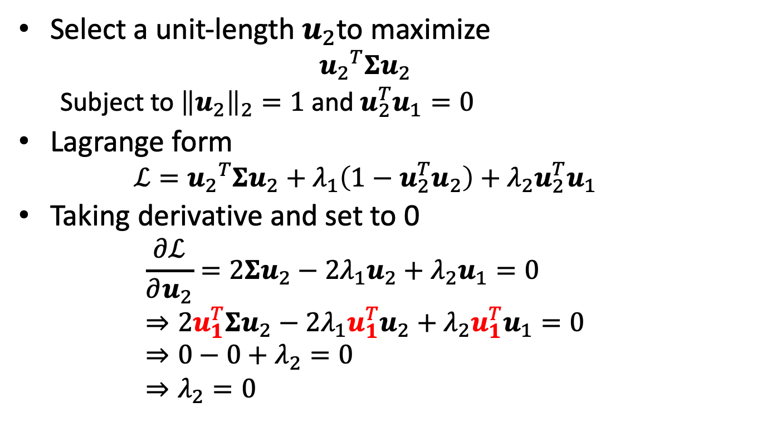

Finding $u_{2}$
Select a unit-length $u_{2}$to maximize
$${u_{2}}^{T}Σu_{2}$$
Subject to ${\left\|u_{2}\right\|}_{2}=1$ and $u_{2}^{T}u_{1}=0$
Lagrange form
$$ℒ={u_{2}}^{T}Σu_{2}+λ_{1}\left(1−u_{2}^{T}u_{2}\right)+λ_{2}u_{2}^{T}u_{1}$$
Taking derivative and set to 0
$$\frac{∂ℒ}{∂u_{2}}=2Σu_{2}−2λ_{1}u_{2}+λ_{2}u_{1}=0 \\ ⇒2u_{1}^{T}Σu_{2}−2λ_{1}u_{1}^{T}u_{2}+λ_{2}u_{1}^{T}u_{1}=0 \\ ⇒0−0+λ_{2}=0 \\ ⇒λ_{2}=0$$

Slide 13
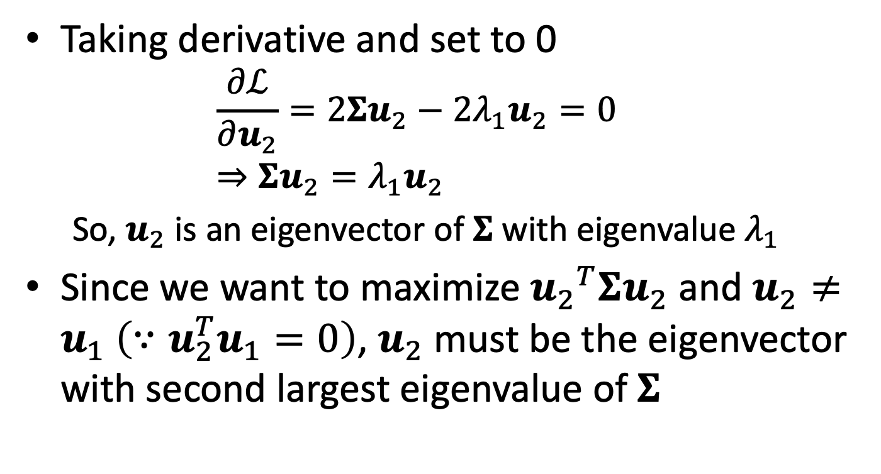

Finding $u_{2}$ (cont’)
Taking derivative and set to 0
$$\frac{∂ℒ}{∂u_{2}}=2Σu_{2}−2λ_{1}u_{2}=0 \\ ⇒Σu_{2}=λ_{1}u_{2}$$ So, $u_{2}$ is an eigenvector of $Σ$ with eigenvalue $λ_{1}$
Since we want to maximize ${u_{2}}^{T}Σu_{2}$ and $u_{2}≠u_{1} \left(∵u_{2}^{T}u_{1}=0\right)$, $u_{2}$ must be the eigenvector with second largest eigenvalue of $Σ$

Slide 14
PCA in general
Perform PCA by computing the eigenvectors of the k largest eigenvalues of the covariance matrix

Slide 15
Autoencoder

Slide 16
Autoencoder
An autoencoder is a neural network whose outputs are its own inputs
Unsupervised (or self-supervised) learning
Objective: minimize reconstruction error
encoder
decoder

Slide 17
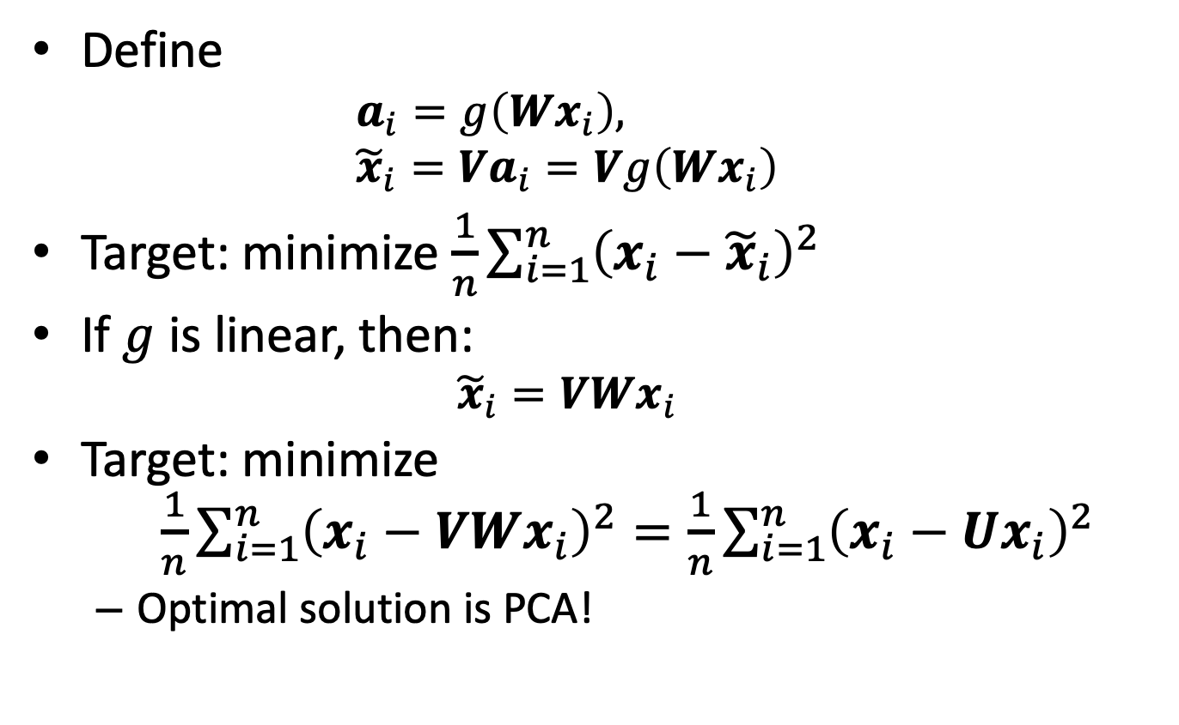
Autoencoder
Define
$$a_{i}=g\left(Wx_{i}\right), \\ {\tilde{x}}_{i}=Va_{i}=Vg\left(Wx_{i}\right)$$
Target: minimize $\frac{1}{n}\sum_{i=1}^{n}{{\left(x_{i}−{\tilde{x}}_{i}\right)}^{2}}$
If $g$ is linear, then:
$${\tilde{x}}_{i}=VWx_{i}$$
Target: minimize $\frac{1}{n}\sum_{i=1}^{n}{{\left(x_{i}−VWx_{i}\right)}^{2}}=\frac{1}{n}\sum_{i=1}^{n}{{\left(x_{i}−Ux_{i}\right)}^{2}}$
Optimal solution is PCA!

Slide 18
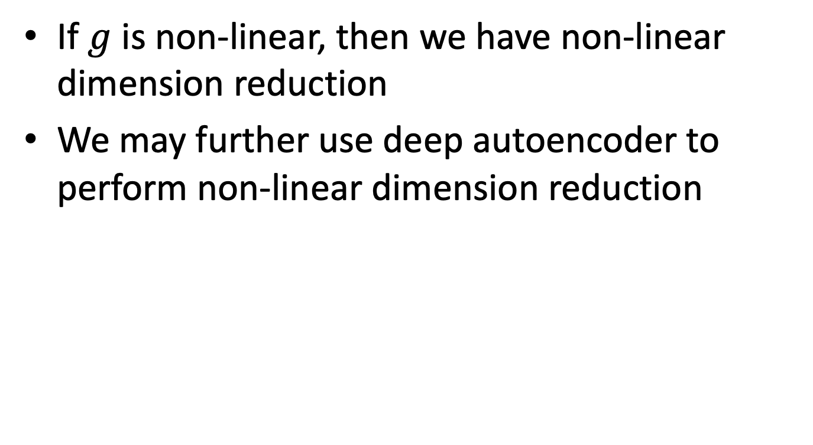
Autoencoder as non-linear PCA
If $g$ is non-linear, then we have non-linear dimension reduction
We may further use deep autoencoder to perform non-linear dimension reduction

Slide 19
Autoencoder example

Slide 20

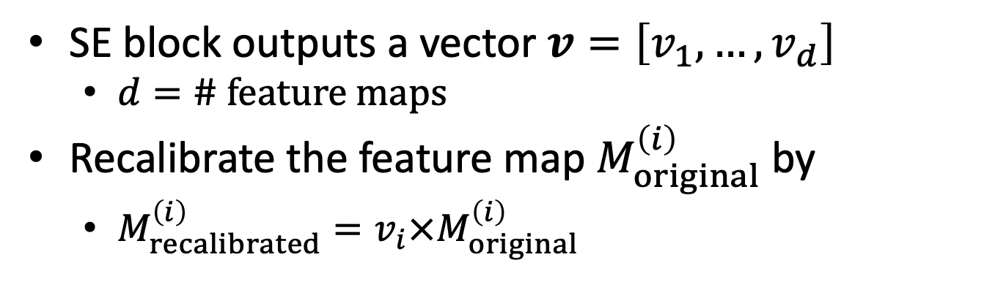
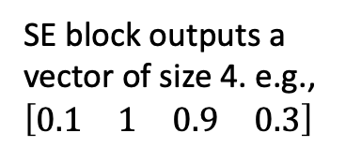
Remember the SE network?
# feature maps: 4
SE block outputs a vector of size 4. e.g., $\left[\begin{matrix}\begin{matrix}0.1 & 1\end{matrix} & \begin{matrix}0.9 & 0.3\end{matrix}\end{matrix}\right]$
SE block
$$×$$
Original feature maps
Elementwise product
Recalibrated feature maps
SE block outputs a vector $v=\left[v_{1},…,v_{d}\right]$
$d=\# feature maps$
Recalibrate the feature map $M_{original}^{\left(i\right)}$by
$M_{recalibrated}^{\left(i\right)}=v_{i}×M_{original}^{\left(i\right)}$

Slide 21
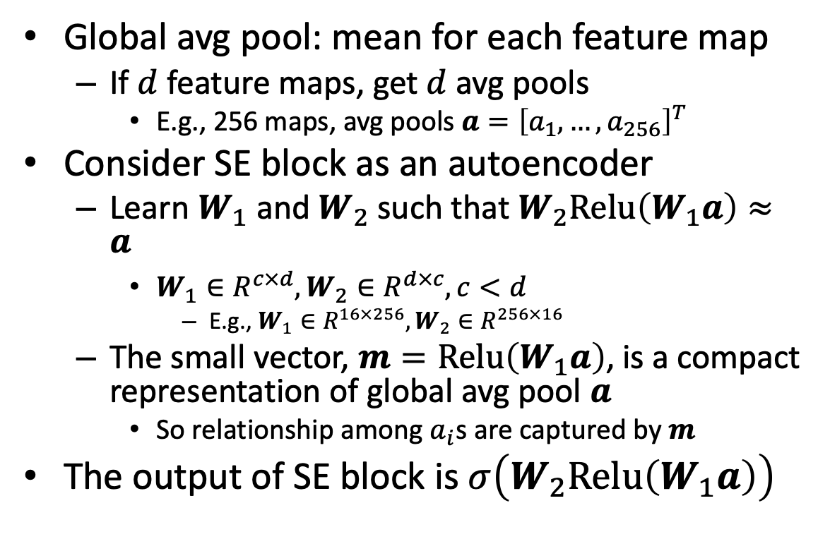
SE block architecture
Global avg pool: mean for each feature map
If $d$ feature maps, get $d$ avg pools
E.g., 256 maps, avg pools $a={\left[a_{1},…,a_{256}\right]}^{T}$
Consider SE block as an autoencoder
Learn $W_{1}$ and $W_{2}$ such that $W_{2}Relu\left(W_{1}a\right)≈a$
$W_{1}∈R^{c×d},W_{2}∈R^{d×c}, c<d$
E.g., $W_{1}∈R^{16×256},W_{2}∈R^{256×16}$
The small vector, $m=Relu\left(W_{1}a\right)$, is a compact representation of global avg pool $a$
So relationship among $a_{i}$s are captured by $m$
The output of SE block is $σ\left(W_{2}Relu\left(W_{1}a\right)\right)$
Dense
Dense
Global avg pool

Slide 22
Stacked autoencoder

Slide 23
Convolutional autoencoder
Two main structure of a CNN:
Convolution
Pooling
Convolutional autoencoder
Encoder
Consists of convolutional layers and pooling layers
Downscale spatial dimensionality (i.e., height and weight) but increase depth (i.e., # feature maps)
Decoder:
Upscale spatial size and reduce depth back to original dimensions

Slide 24
Convolutional autoencoder
Up-sampling

Slide 25
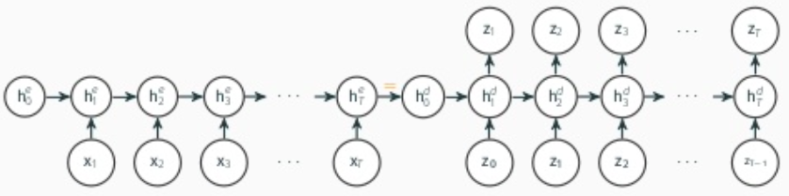
Recurrent autoencoder
Similar to the encoder-decoder model
Encoder is a sequence-to-vector RNN
Decoder is a vector-to-sequence RNN

Slide 26
Denoising autoencoder
Add noise to input
Network tries to recover the original (noise-free) input

Slide 27
Variational autoencoder
Variational autoencoder is unique because
It is a generative model
The output is probabilistic

Slide 28
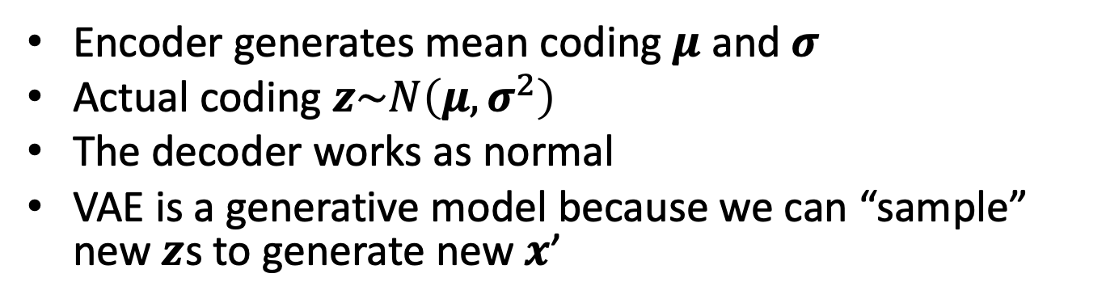
Variational autoencoder
Encoder generates mean coding $μ$ and $σ$
Actual coding $z\sim N\left(μ, σ^{2}\right)$
The decoder works as normal
VAE is a generative model because we can “sample” new $z$s to generate new $x$’

Slide 29
Summary
PCA linearly projects data points into low dimension
Good interpretability
Can project new data points
Autoencoder projects the data points non-linearly
Interpretability?
AE vs Word2Vec
VAE can generate new instances

